Slide 1
Internet Safety

Slide 2
Quiz
Quiz
Oovoo
Xbox Kinect
WhatsApp
YouTube
Roblox
Musical.ly
Twitter
Instagram
Facebook
SnapChat

Slide 3
Age Restrictions for Social Media
Age Restrictions for Social Media
13

Slide 4
Jigsaw

Slide 5
Reduce the Risks

Slide 6
Lock Your Devices
Always set a secure password.
Pass lock your phone/mobile devices.

Slide 7
Be Share Aware
Don’t share personal information with people you don’t know.

Slide 8
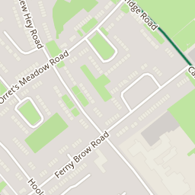
THINK Before you Post

Slide 9
THINK about how long posts will be available

Slide 10
THINK carefully about who you add

Slide 11
THINK About who is watching

Slide 12
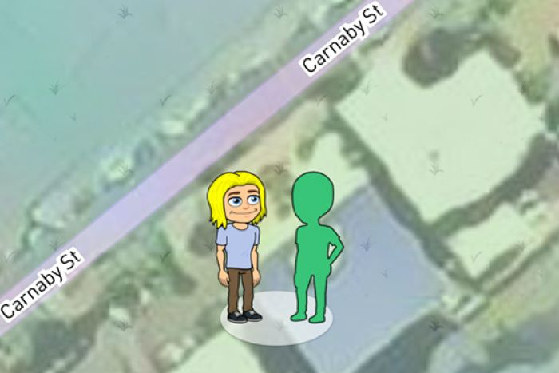
Turn off Location Settings

Slide 13
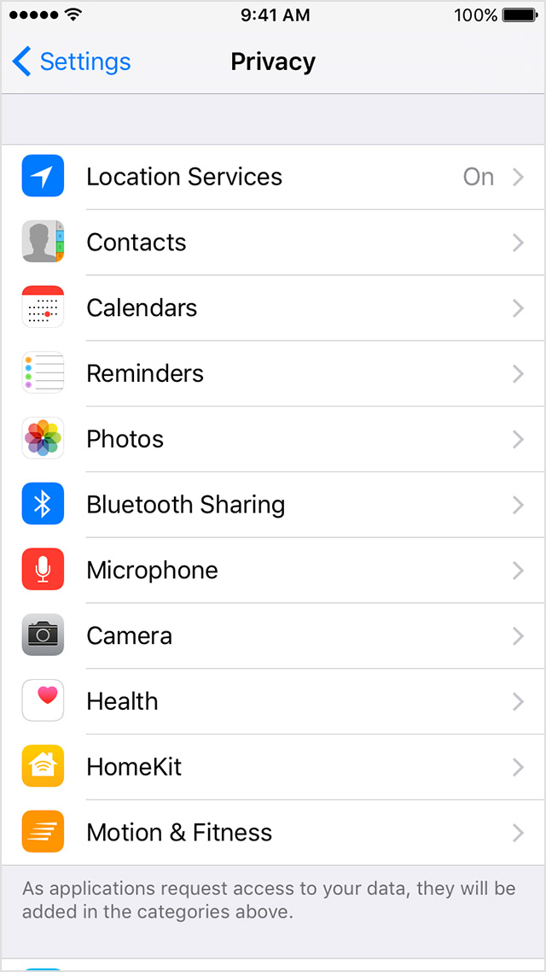
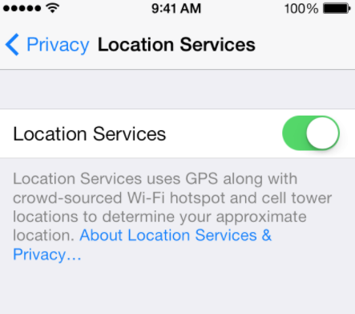
Turn off Location Settings

Slide 14
Choose Ghost Mode

Slide 15
Keep your Accounts Private

Slide 16
How can you get help?

Slide 17
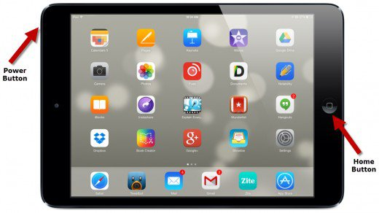
Take a Screen Shot

Slide 18
Who can you tell?

Slide 19
Do you have any Questions?
?

