Slide 1

Parent support for Mathematics
Maths

Slide 2
Practical Resources
SAFETY FIRST : Always supervise your child when using resources.
Resources are vital . Helping children to see the processes involved in maths can help children to visualise what they are doing and why.
Resources help with speech and language as you can help children to construct sentences while moving and using the equipment.
Resources can be bought or use home-made resources such as pasta and bottle tops to help count.
Shapes of objects around the house.
Clocks in the house .
Measure objects in the house. Compare how heavy different household objects are.

Slide 3
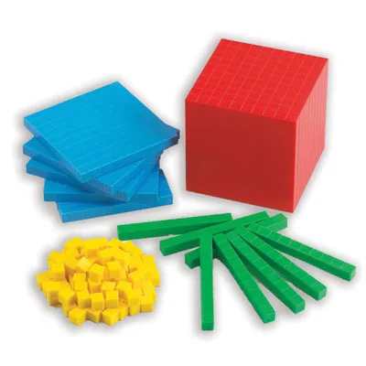
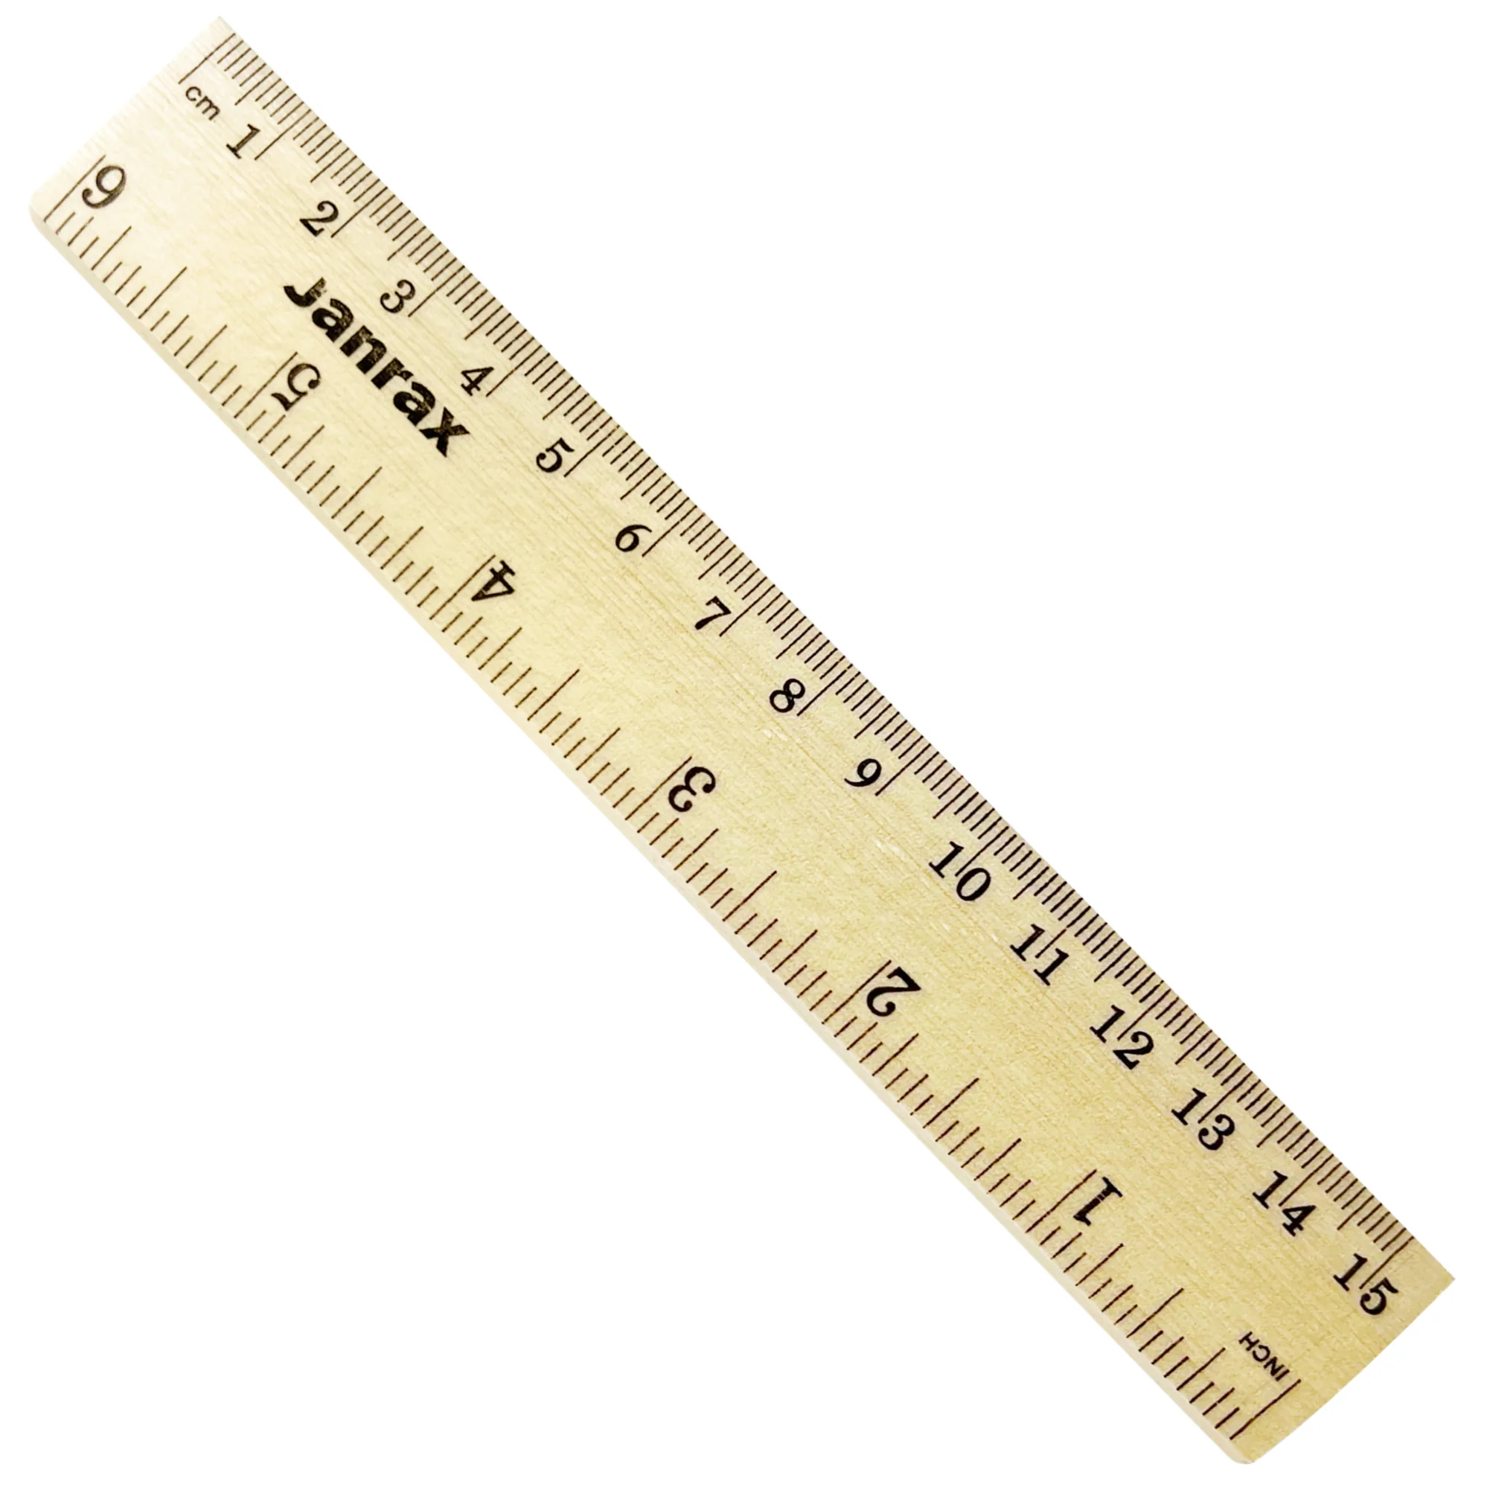
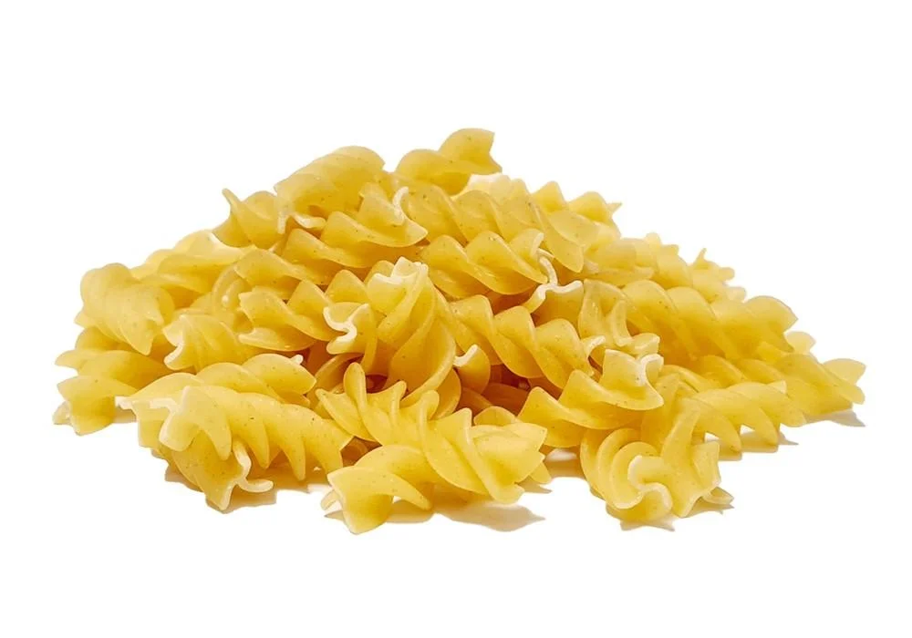
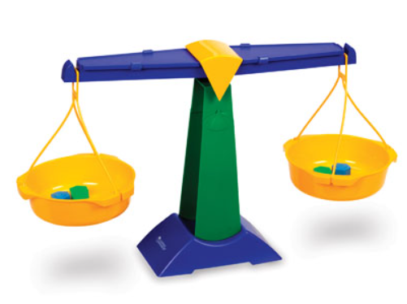
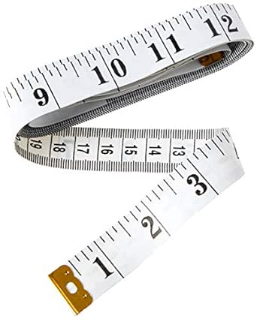
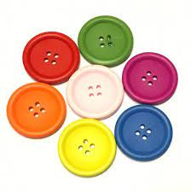
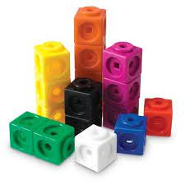
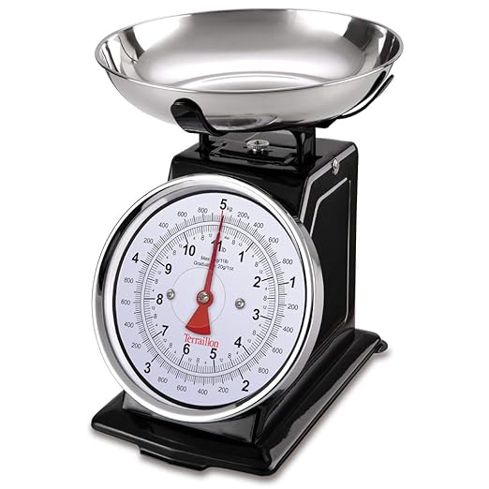

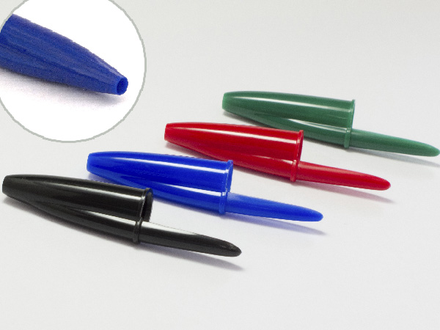
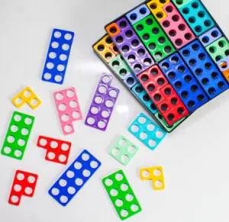

Slide 4
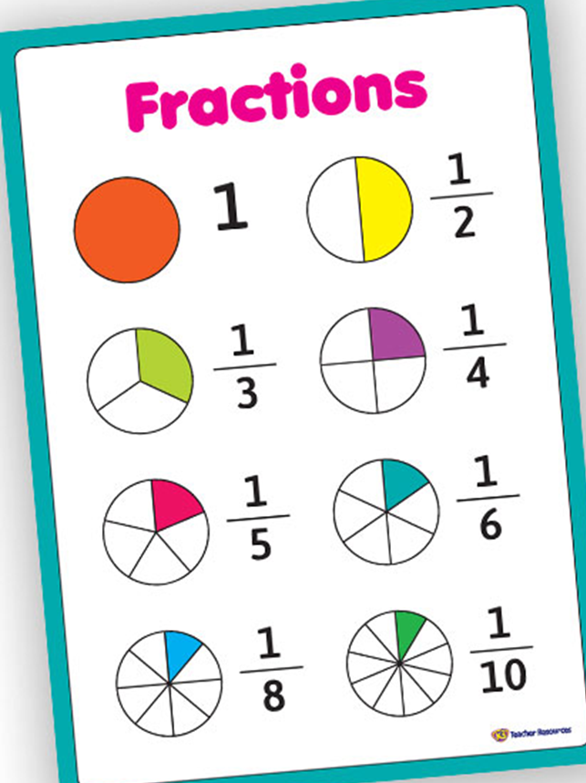
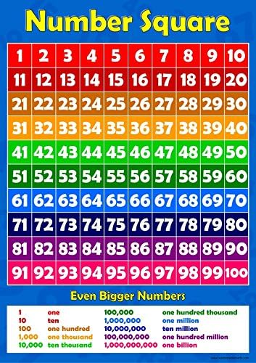
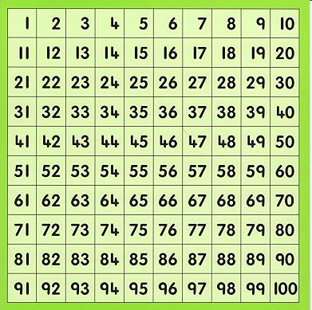
Practical Resources
Paper visual resources can also help.
Many can be located on the internet.
Visual representations support
understanding.

Slide 5
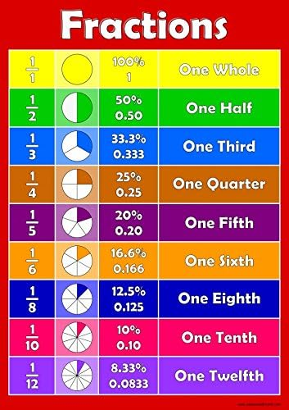
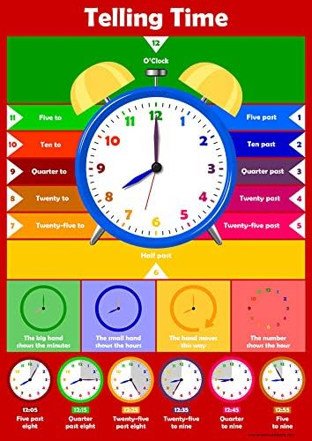
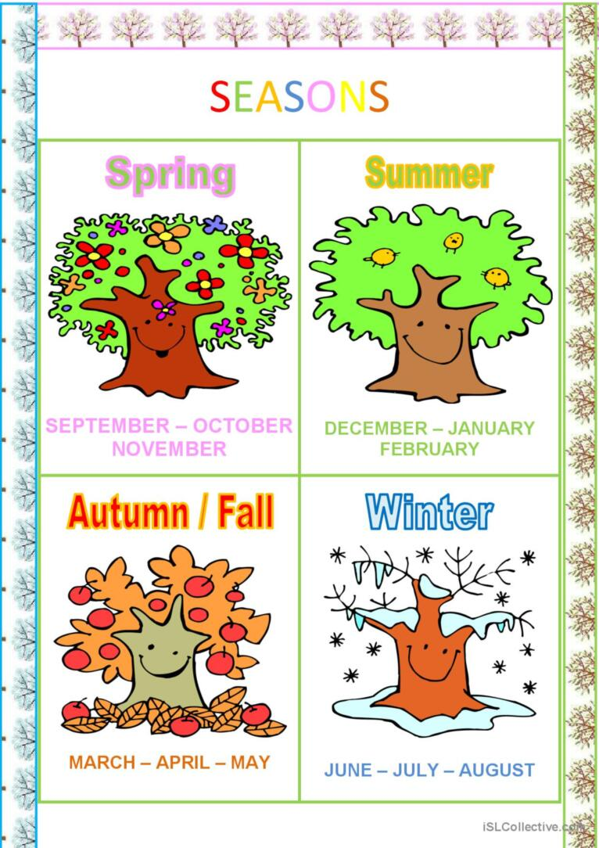
There of lots of posters that you can buy or make.
REMEMBER to talk to your child about what they show and use them to support learning.

Slide 6
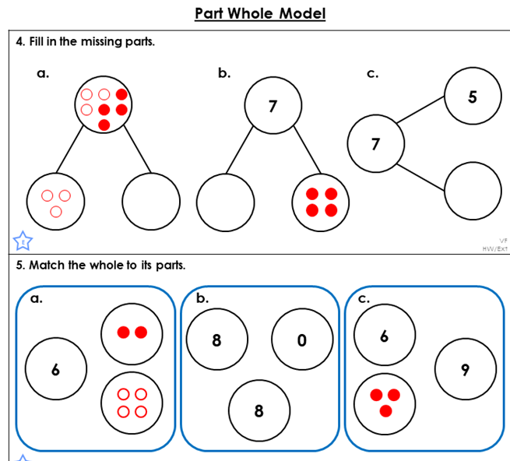
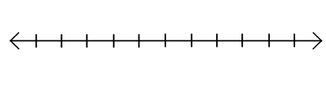
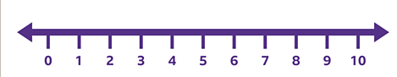
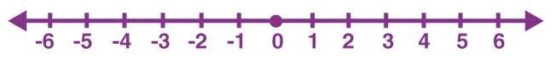
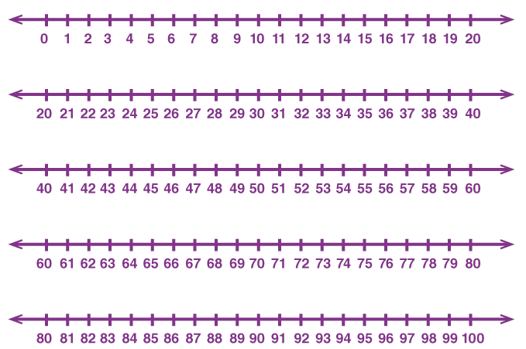
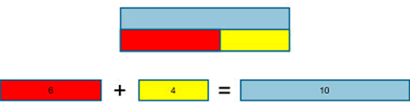
Models and images support learning.
BAR MODEL

Slide 7
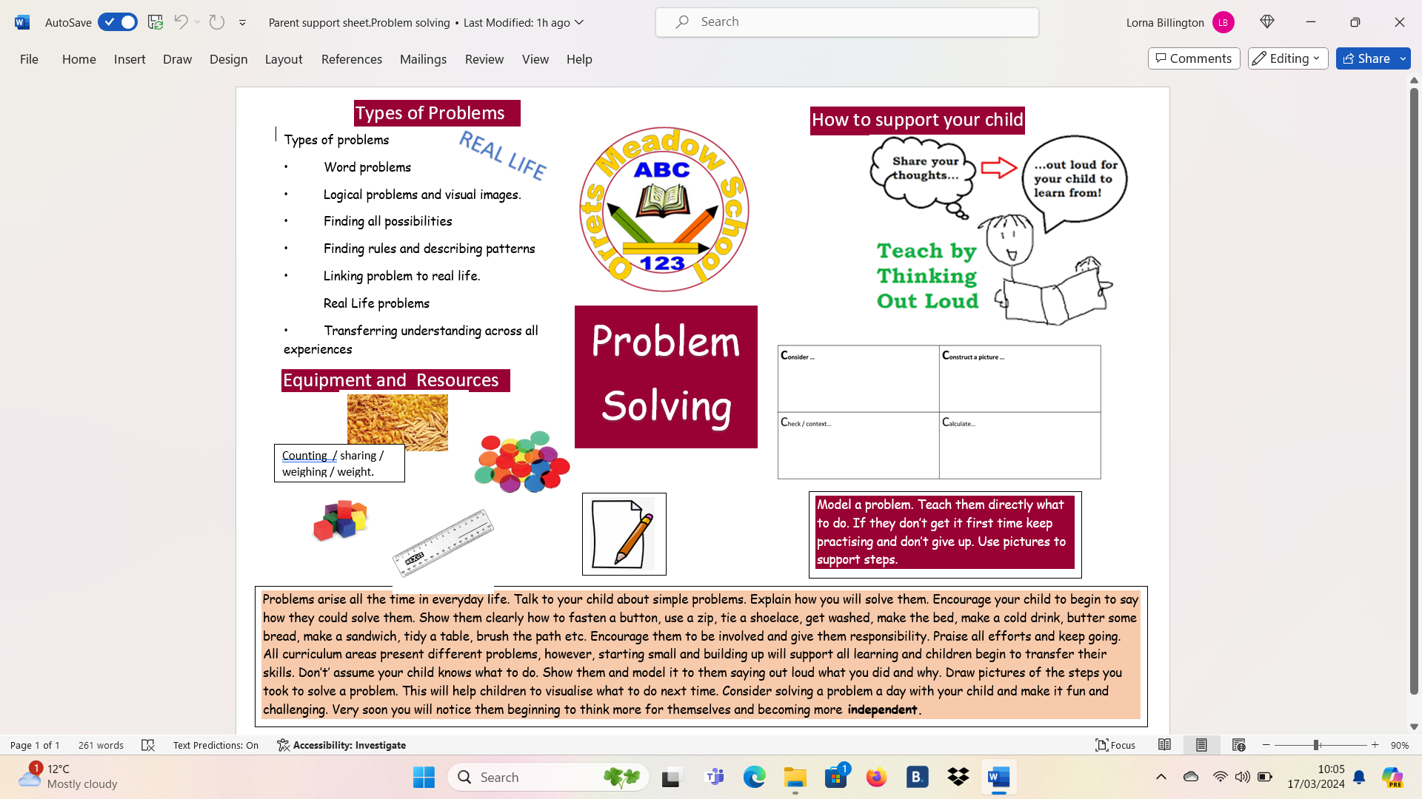

Slide 10
Support for children with additional needs
As we all know children are all different and the amount of support and type will vary.
Scientific research supports that regular discussions and use of practical resources along with exposure to maths language and techniques supports a child’s mental maths and practical theoretical understanding.
Overlearning is important to help learning pathways form in the brain. This helps children to retain information for a longer time and helps to build on prior knowledge.
In school our long-term plan supports overlearning and the use of models , images and practical resources.

Slide 11
STEM SENTENCES: Support learning by modelling sentences.
e.g
I know that if I add 2 and 8 I will get ten.
Repeat with different bonds.
Encourage your child to form the bonds with counters etc while doing this.
STEM sentences can be used in many different situations and all areas of maths.
The teacher or parent models, the child copies and then as their confidence increases, they become more able to construct their own sentences with understanding.
Models and Images
Both the bar model and Part whole model approaches support learning and understanding.
Useful websites:
https://www.bbc.co.uk/bitesize
https://www.topmarks.co.uk/
https://www.mathletics.com/uk/

Slide 12

Support for Maths
Further Maths information can be found on our school website including the Maths Policy and the maths calculation policy.
Please remember although a lot of the children are brought to school by taxi, we continue to have easy access to our staff who are able to give help and advice about your child and their learning in maths. If you feel you need more support, then feel free to contact them.
School number 0151- 678-8070

